Slide 1
Big Mountain Resort Ticket Price Evaluation

Slide 2
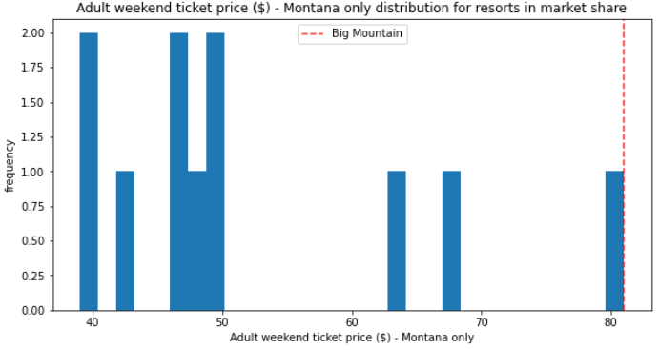
Is our current price of $81 for an Adult Ticket appropriate?
Pre-analysis views on BMR pricing:
BMR provides high quality amenities that justifies the premium our guests pay for admission.
BMR’s ticket price is the most expensive in Montana and needs to be reduced to increase attendance.

Slide 3
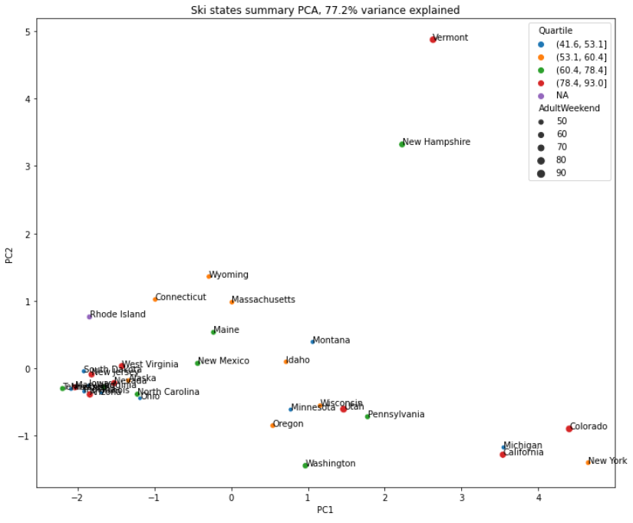
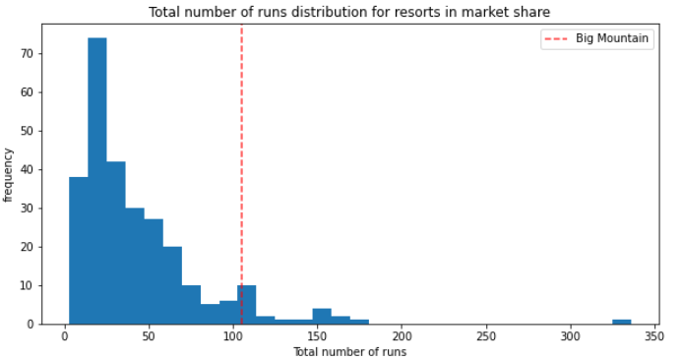
Key findings:
When evaluating ticket pricing it is more appropriate to consider the entire population of 277 ski resorts with quality data instead of just Montana resorts.
Ticket price based on modeling from competitor data suggests that BMR’s amenities could support a ticket price of $95.
Additional profit could also be generated by reducing amenities (such as closure of some runs) to better reflect the current $81 ticket price.
Montana ski resorts within the cloud

Slide 4
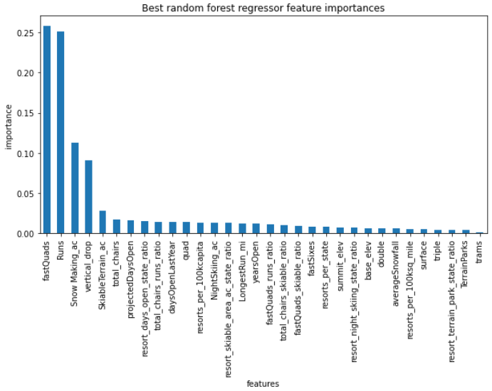
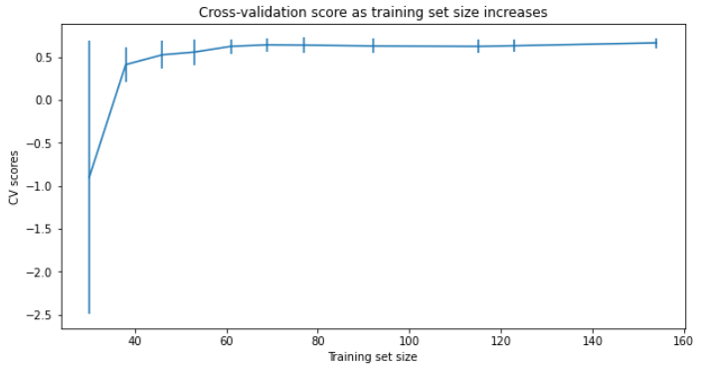
Model Results:
The lowest error model generated in this analysis was a random forest.
Mean absolute error of resultant model was $9.54
# of Fast Quads, # of Runs, Snow Making Ac., and Vertical Drop were the most influential features
Sufficient data was provided based on CV scores

Slide 5
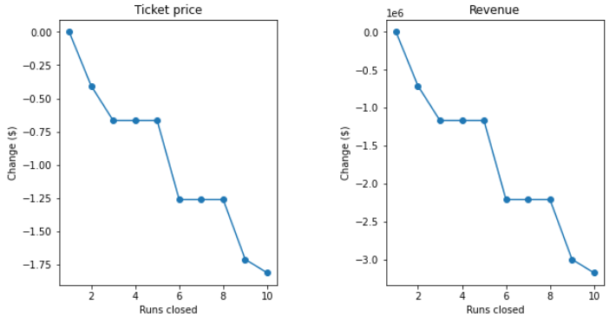
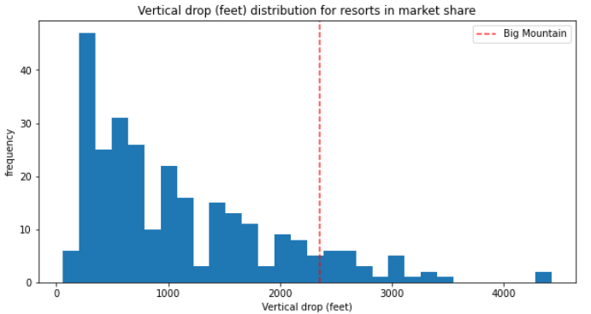
Scenarios evaluated:
Close up to 10 runs - The modeling seems to indicate that there are some logical breaks in the closing of runs. Closing 3 to 5 runs reduces the price support by $0.67, and 6 to 8 reduces it by $1.26.
Increase vertical drop by 150’ - This would increase price support by $1.99 ($3.5MM for the season) prices were increased to reflect this change.

Slide 6
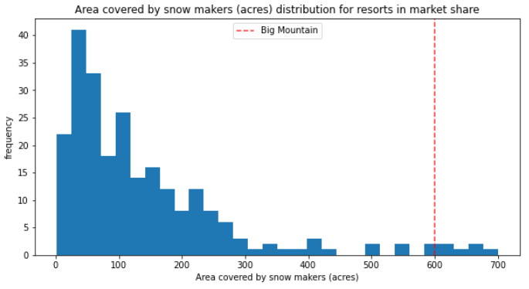
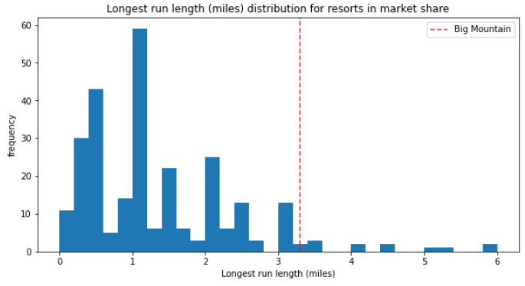
Scenarios evaluated:
3)
4)
Scenario 2 with the addition of 2 acres of snow making - This adds no value when compared to scenario 2
Increase the longest run by 0.2 miles - This adds no additional value in this model

Slide 7
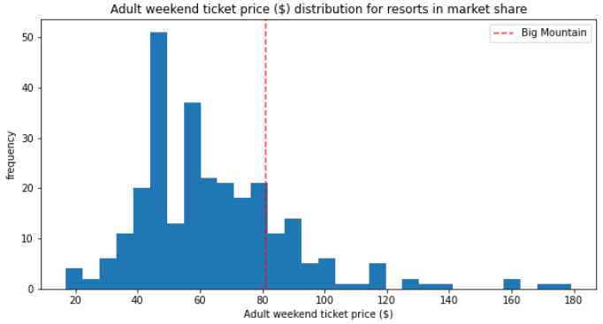
Conclusion: BMR’s $81 Adult Ticket price is below modeled price
Based on modeling results based on competitor amenities there is significant evidence that BMR could adjust justify a price increase to as high as $95 (+ $9.50) with current amenities.
An alternative approach to increasing profit would be to reduce some of the less impactful amenities to reduce operating costs while maintaining current pricing.
Amenity based price + error

